Slide 1
Lab meeting 17.08.2020
Maurice Halder

Slide 2
Background
Over 1 million stenting procedures
in Europe alone
10% → severe complications

Slide 3
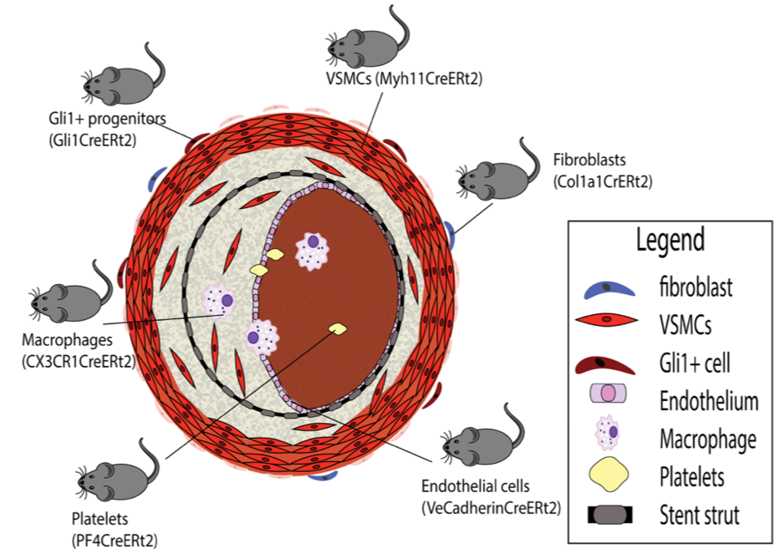
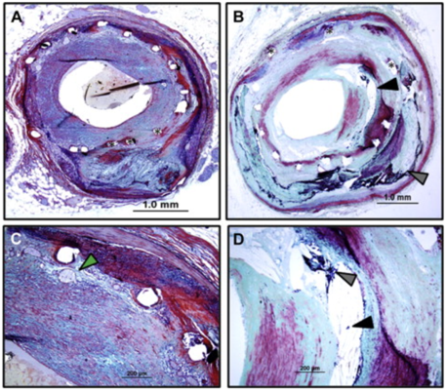
Our objective:
Stent-mediated stress
Neointima formation
Stent restenosis
To figure out which cells/mechanisms are responsible for neointima formation
VSMCs?
Gli1⁺ pericytes?

Slide 4
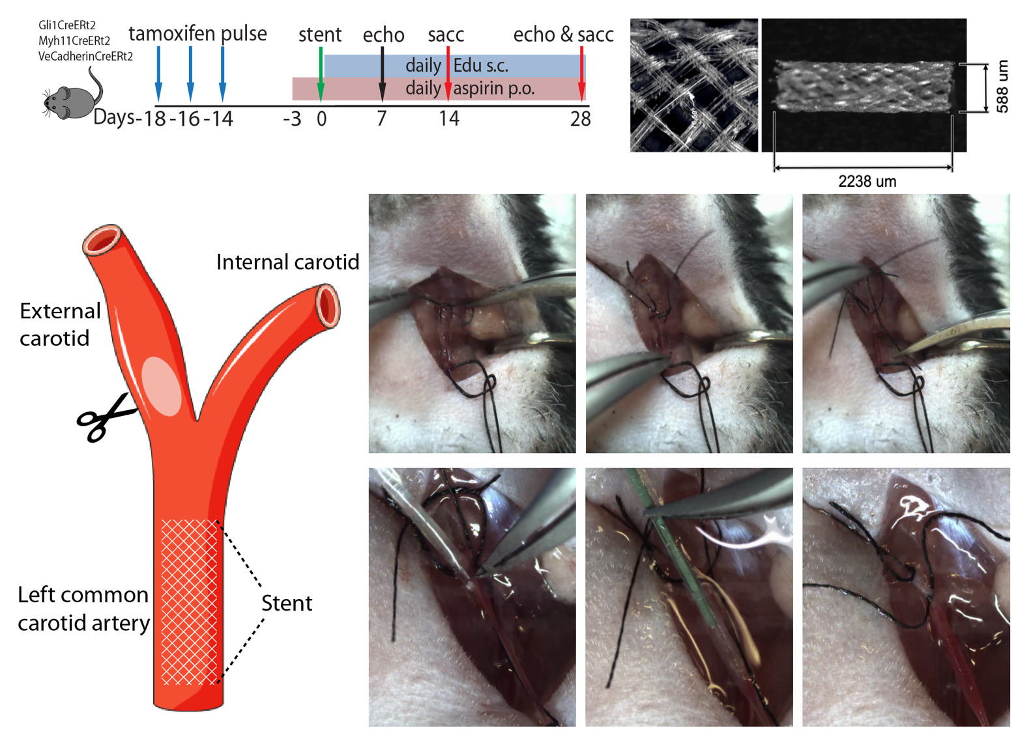
Notes:
Polyvinylidene fluoride (PVDF)

Slide 5
Gli1+ tdTomato cells in healthy carotid
DAPI
Calponin
Gli1+

Slide 6
Myh11 tdTomato cells in medial layer of healthy carotid
DAPI
Calponin
Myh11

Slide 7
VeCadherin tdTomato cells in endothelium of healthy carotid
DAPI
CD31
VeCadherin

Slide 8
Cre driver expression per vascular layer in healthy carotids

Slide 9
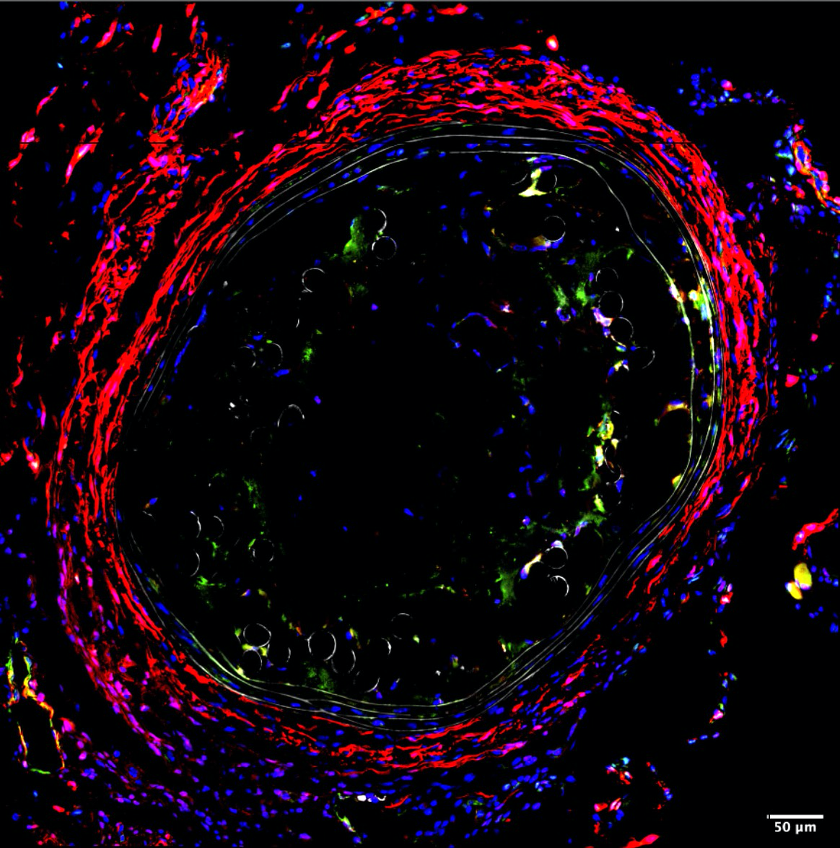
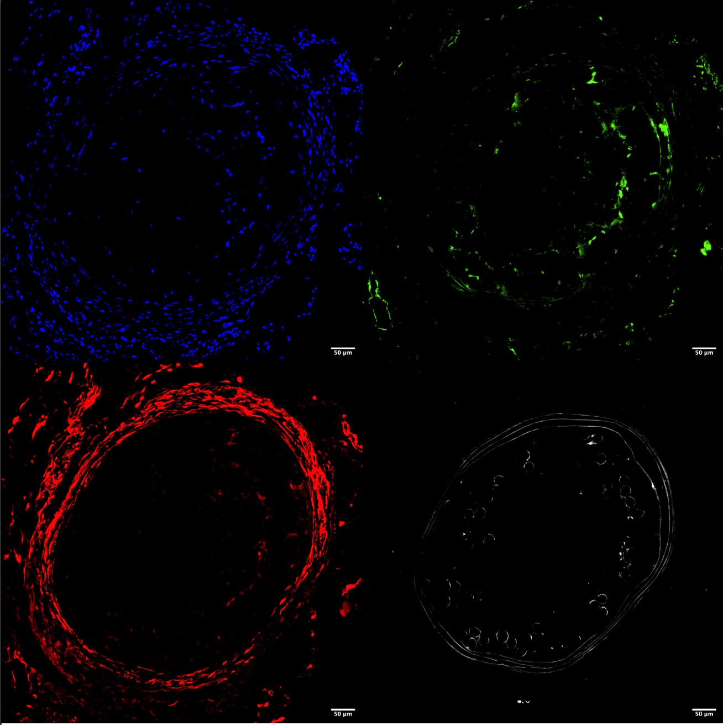
Gli1+ in stented carotid 2 weeks
DAPI
Calponin
Gli1+
Edu

Slide 10
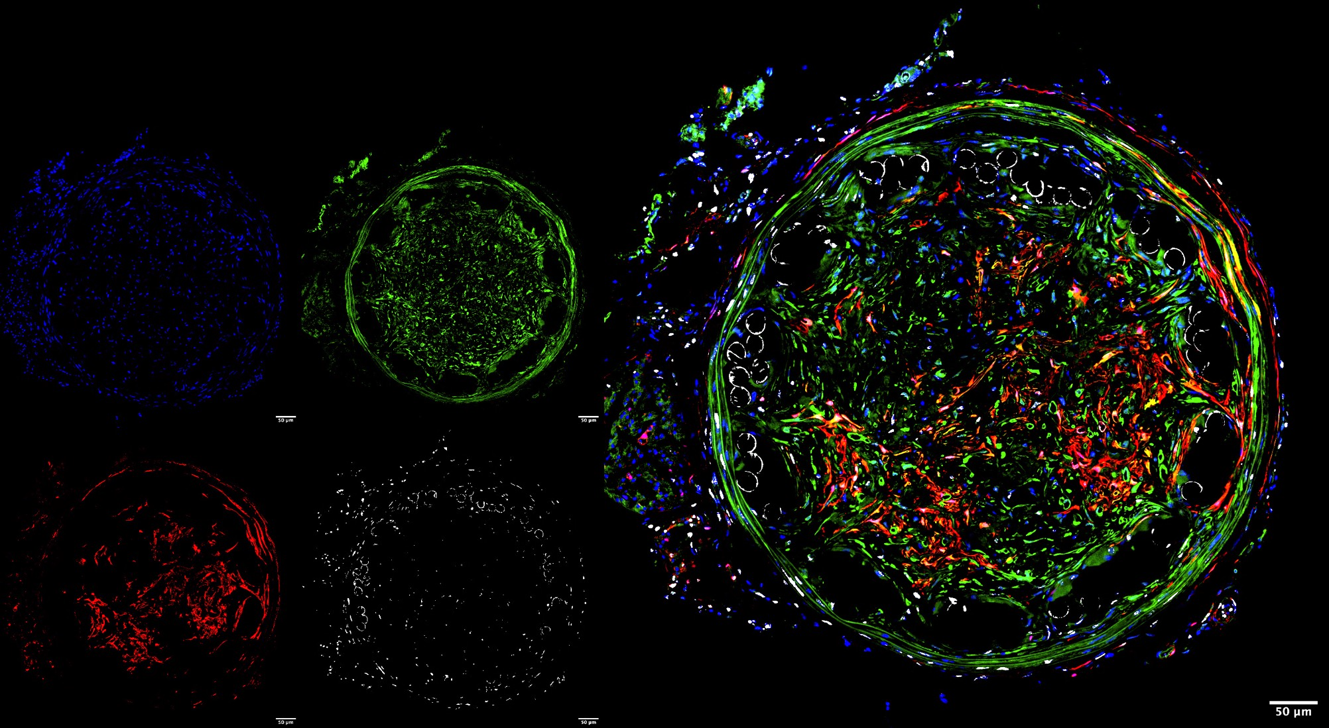
Gli1+ in stented carotid 4 weeks
DAPI
Calponin
Gli1+
Edu

Slide 11
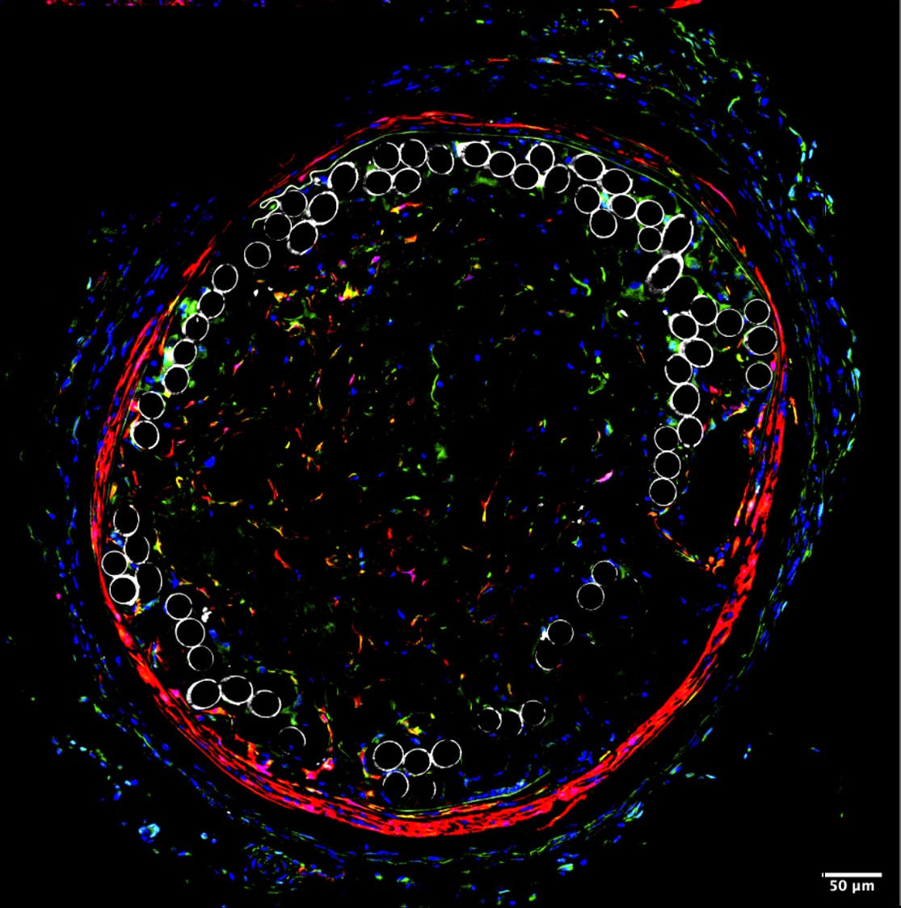
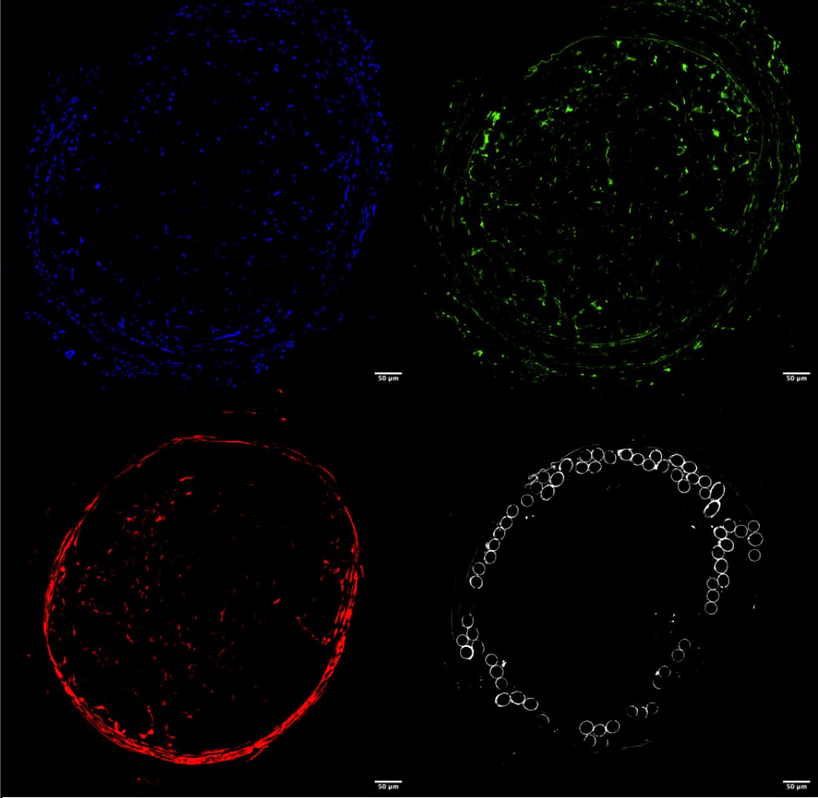
Myh11 in stented carotid 2 weeks
DAPI
Calponin
Gli1+
Edu

Slide 12
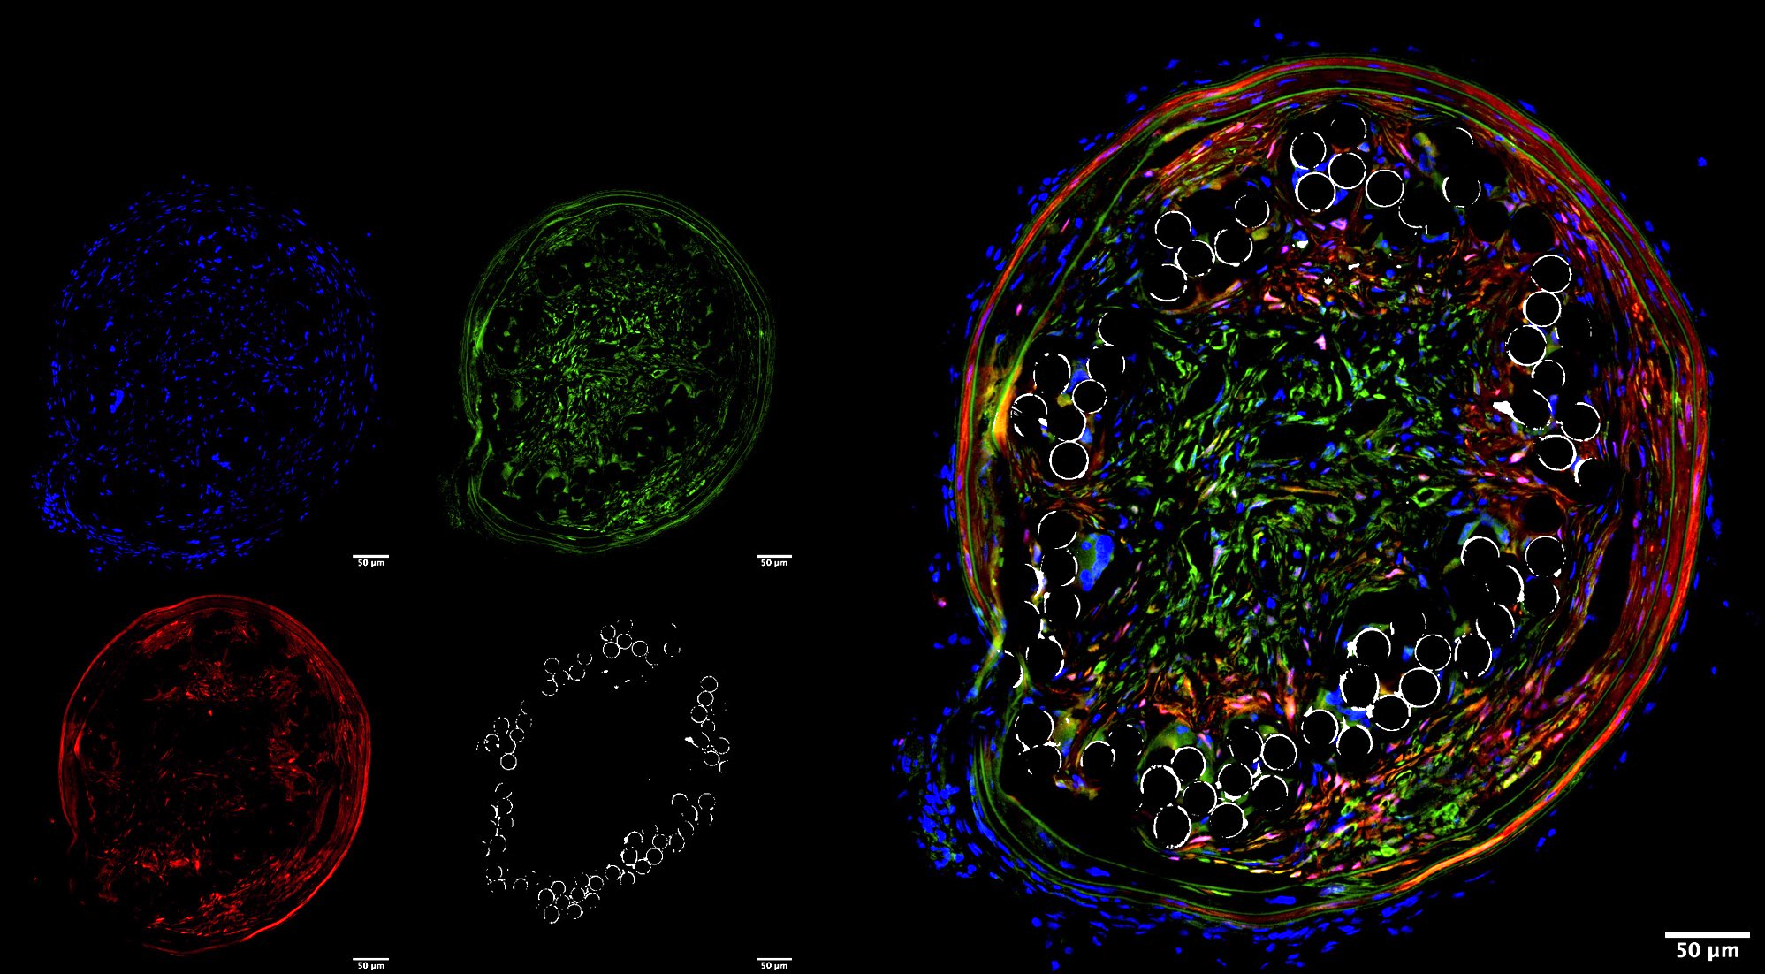
Myh11 in stented carotid 4 weeks
DAPI
Calponin
Myh11
Edu

Slide 13
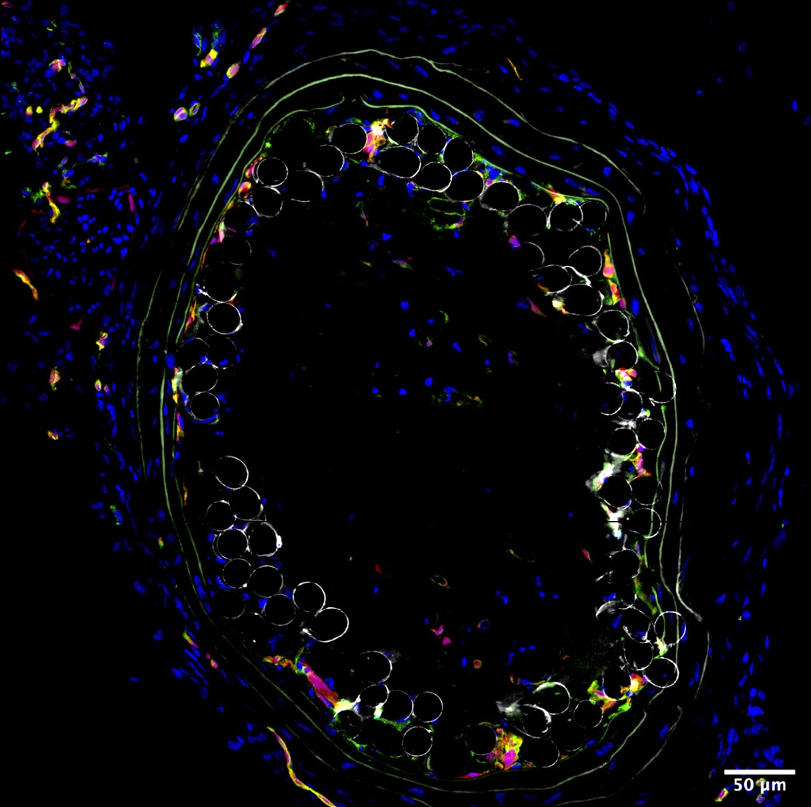
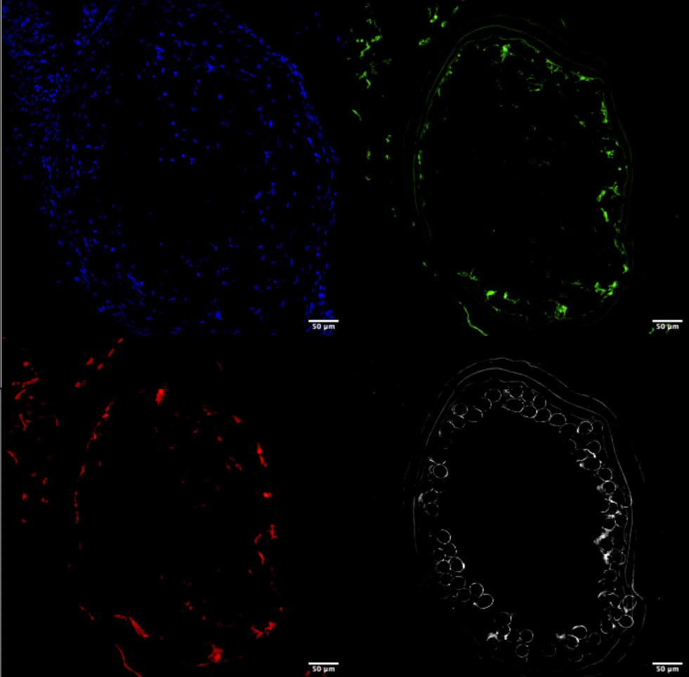
Vecadherin in stented carotid 2 weeks
DAPI
Calponin
Gli1+
Edu

Slide 14
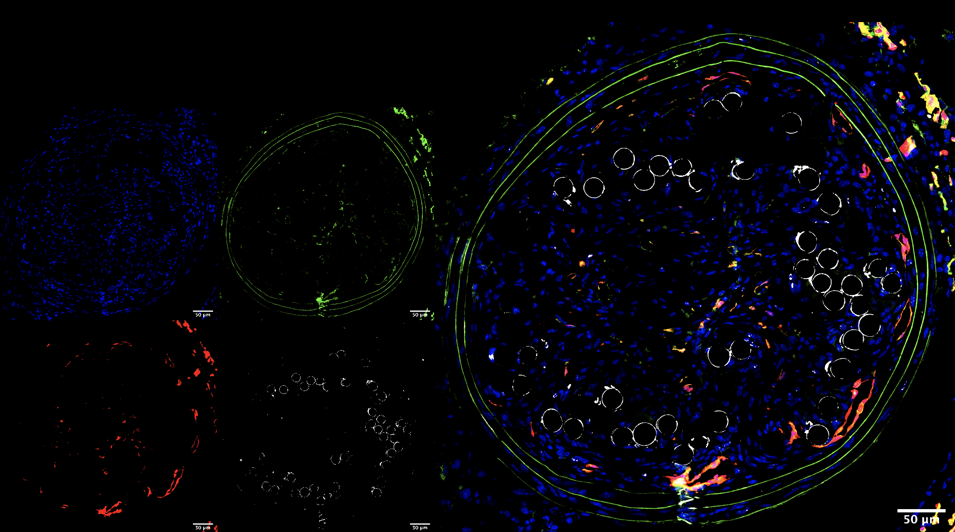
Vecadherin in stented carotid 4 weeks
DAPI
CD31
VeCadherinEdu

Slide 15
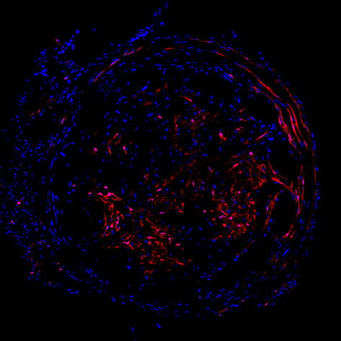
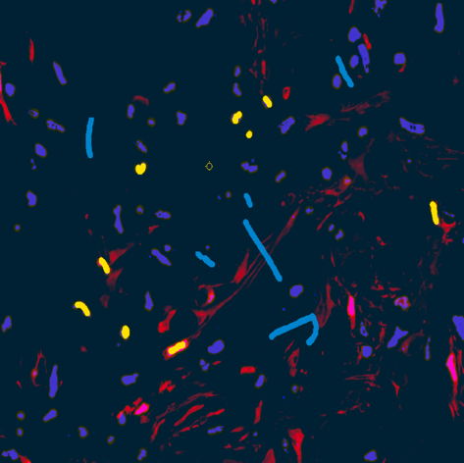
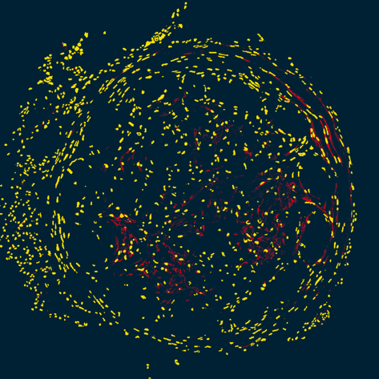
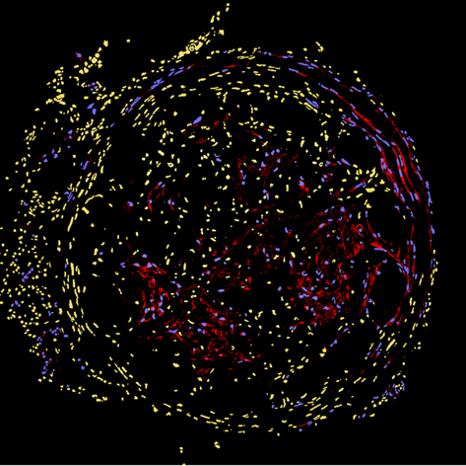
Ilastik
Segmentation by software
Dapi & tdTomato image input
Train software by annotating nuclei and background
Carve out vascular layers using ROIs
neointima
media
adventitia

Slide 16
Neointima cell & TdTom+ population doubles from 2 -> 4 weeks

Slide 17
Cell type contribution statistics to in-stent restenosis
2 weeks after stenting
4 weeks after stenting

Slide 18
No decrease in total cell number or TdTom+ Gli1+ cells in ablated mice

Slide 19
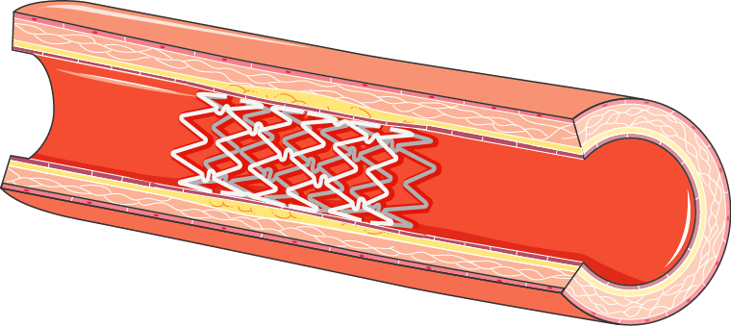
Characterizing the single cell transcriptome of in-stent restenosis
scRNA-seq of stented rat aorta
ApoE deficient rats
Stented vs sham aorta
Enzymatic digestion 30 min
Cell sorting
Singe cell suspension

Slide 20
QC Stented sample
nFeature_RNA > 200 & nFeature_RNA < 3000 & percent.mt < 15)

Slide 21
Stented sample
cluster | N of cells | annotation
0 | 2675 | B-cells
1 | 1334 | T-cells
2 | 558 | T-cells
3 | 421 | Macrophages
4 | 331 | VSMC
5 | 291 | Fibroblast
6 | 272 | Endothelial
7 | 198 | Erythrocytes

Slide 23
Gene markers & TF

Slide 24
QC sham sample
nFeature_RNA > 200 & nFeature_RNA < 3000 & percent.mt < 15

Slide 25
Sham sample
cluster | N of cells | annotation
0 | 288 | Fibroblast
1 | 145 | B-cells
2 | 138 | T-cells
3 | 123 | Erythrocytes
4 | 100 | Endothelial
5 | 76 | Fibroblast
6 | 66 | Macrophages
7 | 39 | VMSC
8 | 33 | Macrophages
9 | 31 | Macrophages

Slide 27
Gene markers & TF
Notes:
Smad3 proliferation VSMC

Slide 28
Integrated dataset
Cluster
0- B-cells
1 T-cells
2 T-cells
3 Fibroblasts
4 Macrophages
5 VSMC
6 RBC
7 endothelial
8 Endothelial
9 …
10 neuron

Slide 30
Cluster
0- B-cells
1 T-cells
2 T-cells
3 Fibroblasts
4 Macrophages
5 VSMC
6 RBC
7 endothelial
8 Endothelial
9 …
10 neuron

Slide 31
Dorothea
Cluster
0- B-cells
1 T-cells
2 T-cells
3 Fibroblasts
4 Macrophages
5 VSMC
6 RBC
7 endothelial
8 Endothelial
9 …
10 neuron

Slide 32
Progeny
Cluster
0- B-cells
1 T-cells
2 T-cells
3 Fibroblasts
4 Macrophages
5 VSMC
6 RBC
7 endothelial
8 Endothelial
9 …
10 neuron

Slide 33
Dorothea and Progeny of only vasculature clusters
Cluster
3 Fibroblasts
5 VSMC
7 endothelial
8 Endothelial
10 neuron

Slide 34
Dorothea and Progeny of only immune clusters
Cluster
0- B-cells
1 T-cells
2 T-cells
4 Macrophages
6 RBC

Slide 35
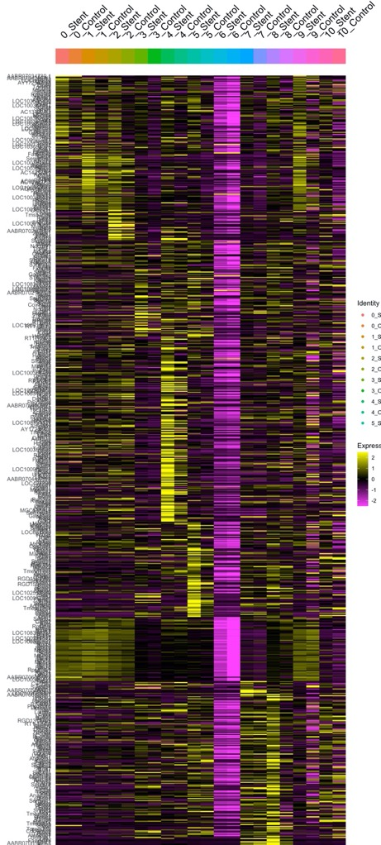
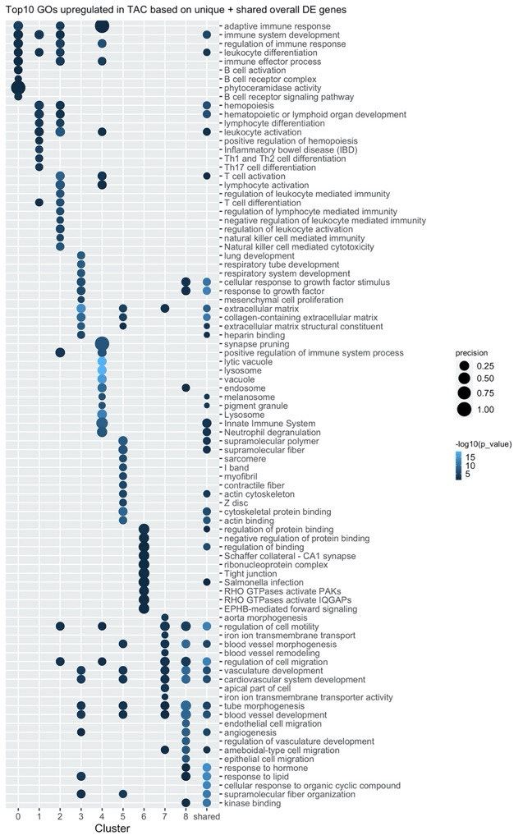
heatmap up DE genes Top10 Go

Slide 36
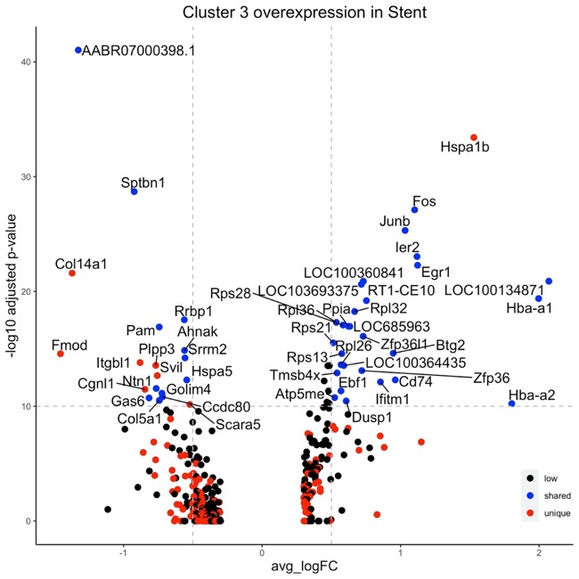
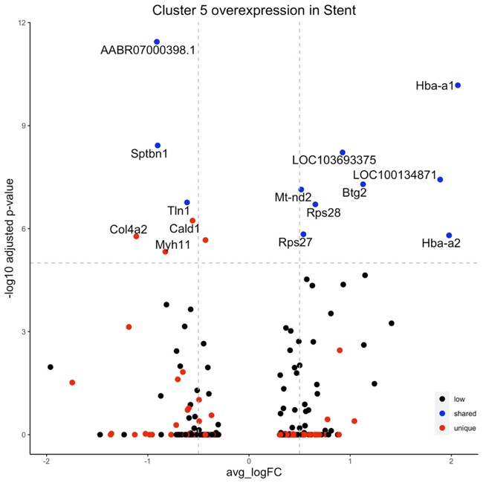
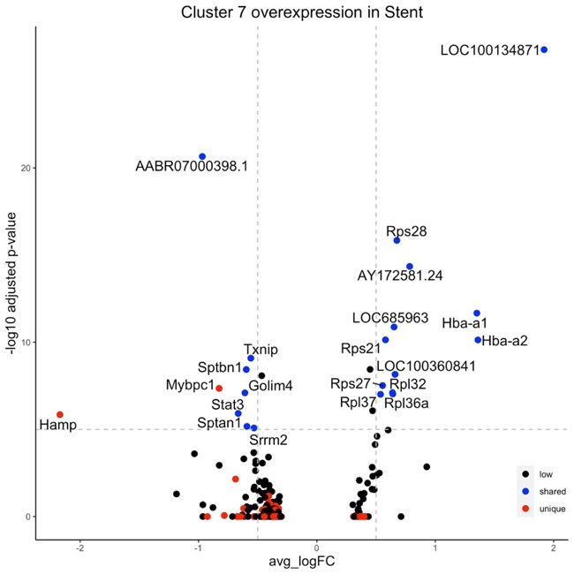
Volcano plots per cluster up in Stent vs control
Fibroblasts
VSMC
Endothelial cells

Slide 37
Further analysis
Receptor ligand interaction immune cells vs. vsmc/fibroblasts
Receptor ligand interaction endothelial cells vs. vsmc/fibroblasts
Analyse where most signalling is coming from
Cellphone DB

Slide 38
Acknowledgements
Prof. Jürgen Floege
Prof. Rafael Kramann
Nadine Kaesler
Sylvia Menzel
Anne Babler
Elisa Liehn
Susanne Ziegler
Christoph Kuppe
Nazanin Kabgani
Aurélien Dugourd
Fabian Peisker
Jack Xu
Peggy Jirak
Nina Graff
Imma-Katrin Härthe
Konrad Hoeft
Vanessa Künstler
Turgay Saritas
Gideon Schäfer
Xiaoting Zhang
Suresh Kaushik
Felix Schreibing
David Schumacher
Katharina Reimer
Lu Chen
Monica Hannani
Ursula Förster
Marius Kohl
Fang-yu Zhao
Lars Koch

Slide 39
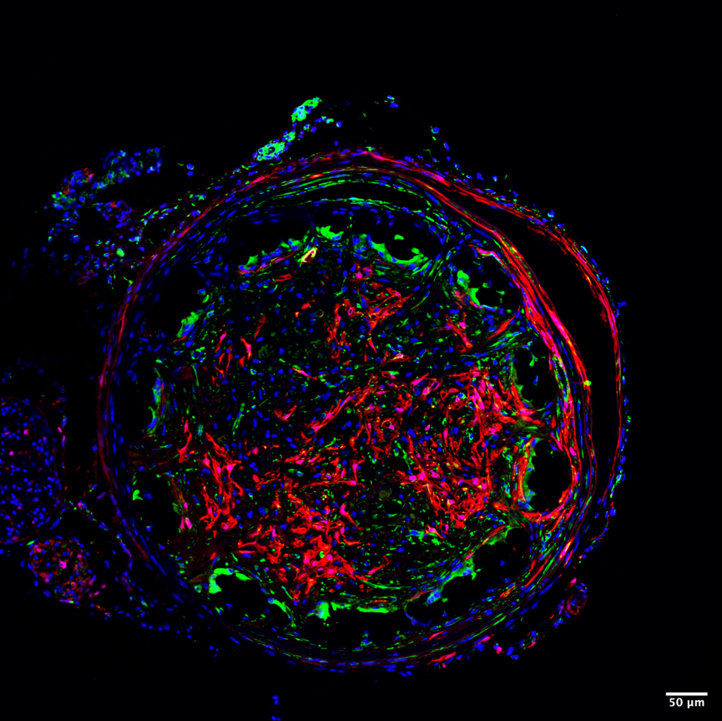
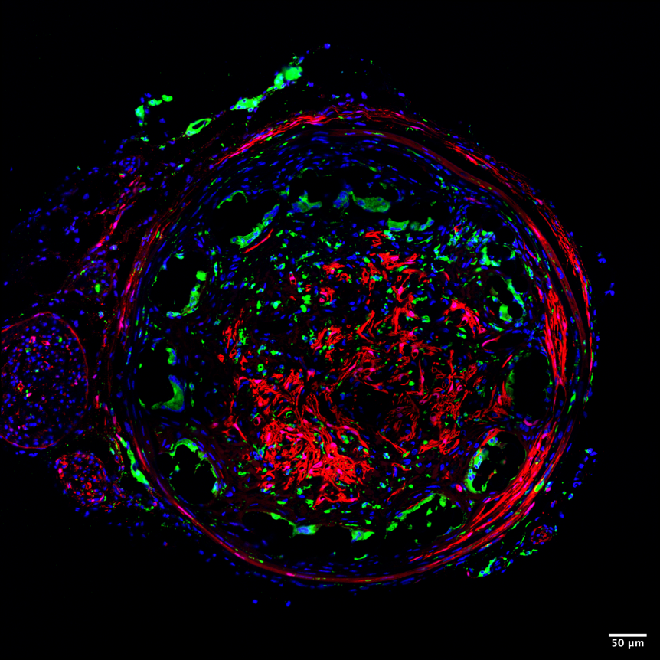
Remaining cells stain positive for immune markers
cd45
cd68

